Slide 1

WELCOME
Please set up an account at www.pythonanywhere.com
We will be using the text www.automatetheboringstuff.com
PYTHON BASICS
Cleveland PyLadies

Slide 2

Flow Control
Objectives:
Learn flow control techniques in Python
Booleans and If…Else
What are operators?

Slide 3
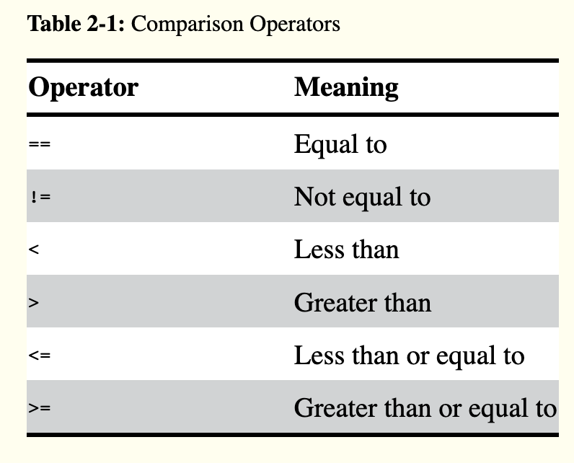
Comparison Operators
These operators evaluate to True or False depending on the values you give them.

Slide 4
Try These Expressions
42 == 42
42 == 99
2 != 3
2 != 2
'hello' == 'hello'
'hello' == 'Hello'
'dog' != 'cat'
42 == 42.0
42 == '42'

Slide 5
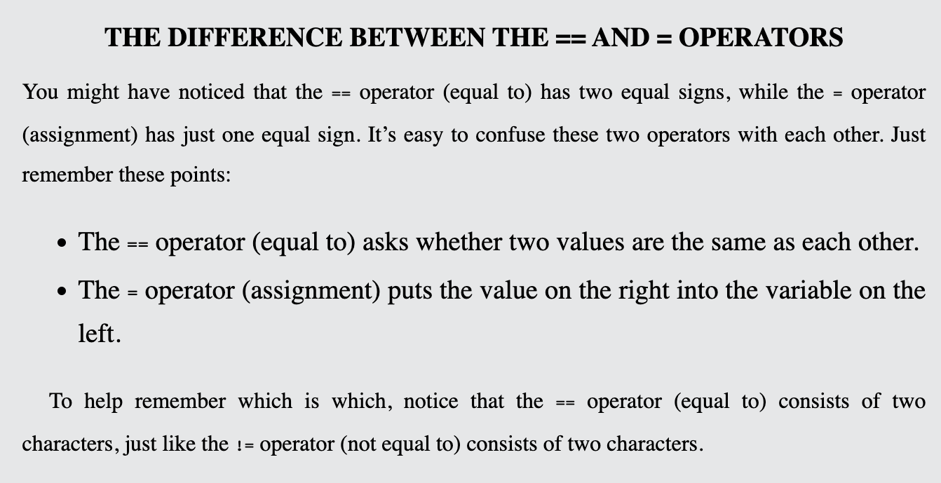
Be careful!

Slide 6
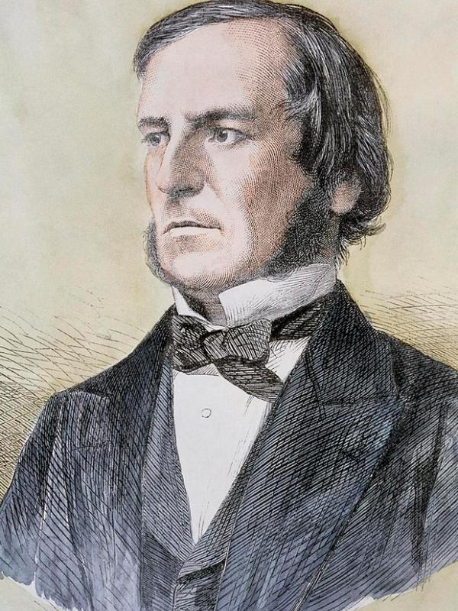
Yes and No
True and False
Booleans are the data type used for True and False
It’s not a number, it’s not a string, it’s a Boolean!
When entered as Python code, the Boolean values True and False lack the quotes you place around strings, and they always start with a capital T or F, with the rest of the word in lowercase.
Like any other value, Boolean values are used in expressions and can be stored in variables ➊. If you don’t use the proper case ➋ or you try to use True and False for variable names, Python will give you an error message.
George Boole
Notes:
George Boole

Slide 7
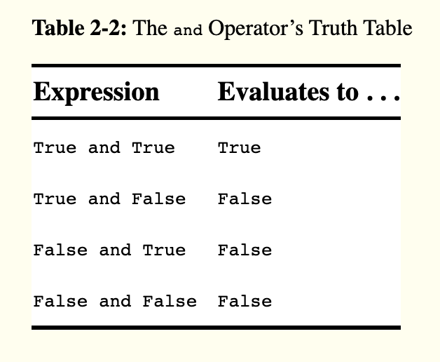
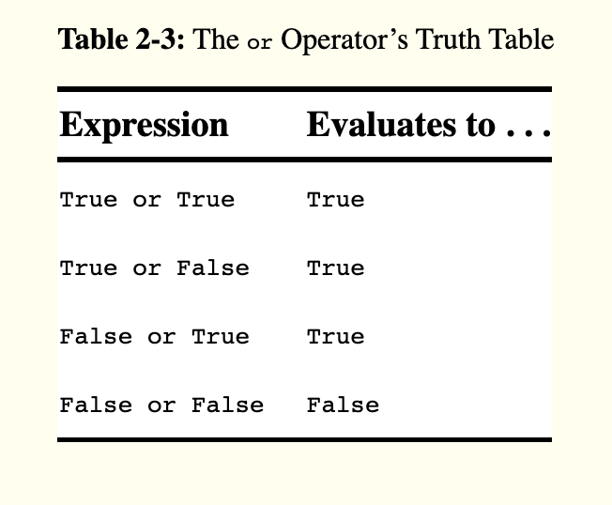
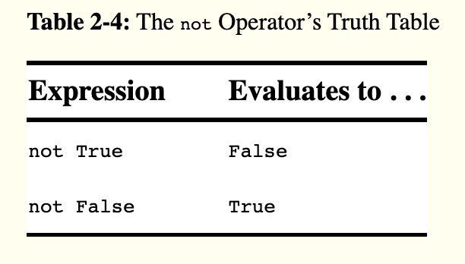
Boolean Operators
and
or
not

Slide 8
Try These Expressions
True and True
True and False
False or True
False or False
not True
not False and True
(4 < 5) and (5 < 6)
(1 == 2) or (2 == 2)

Slide 9
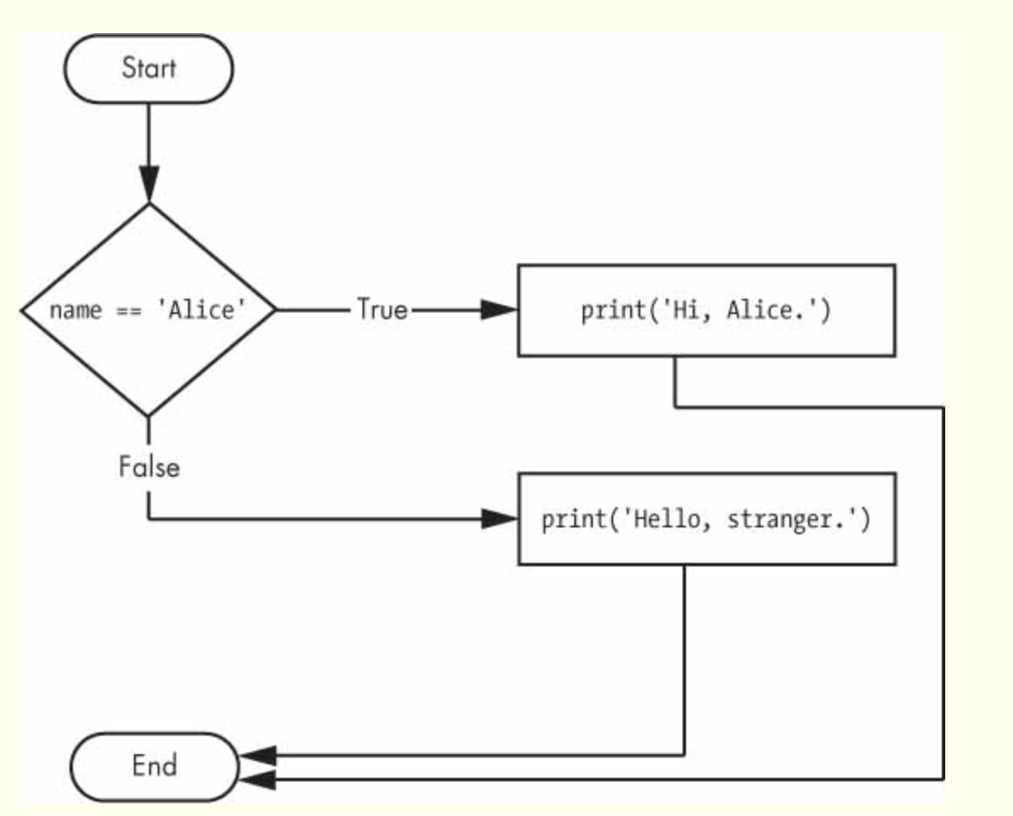
Flow
Control

Slide 10
Build an If-Else statement
name = input(‘what is your name? ’)
if name == “Alice”:
print(‘Hi, Alice’)
else:
print(‘Hi, stranger’)
If & Else
Condition
Colon
Indent

Slide 11
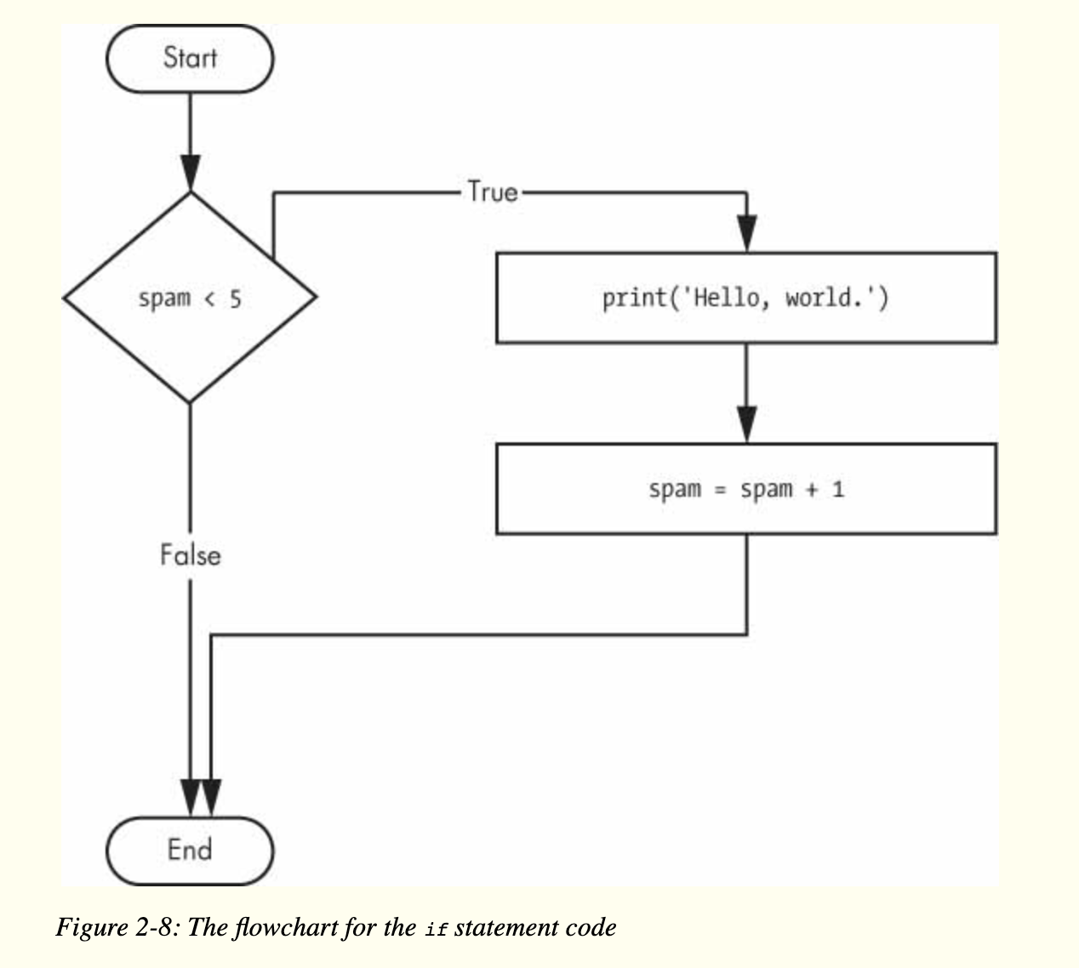
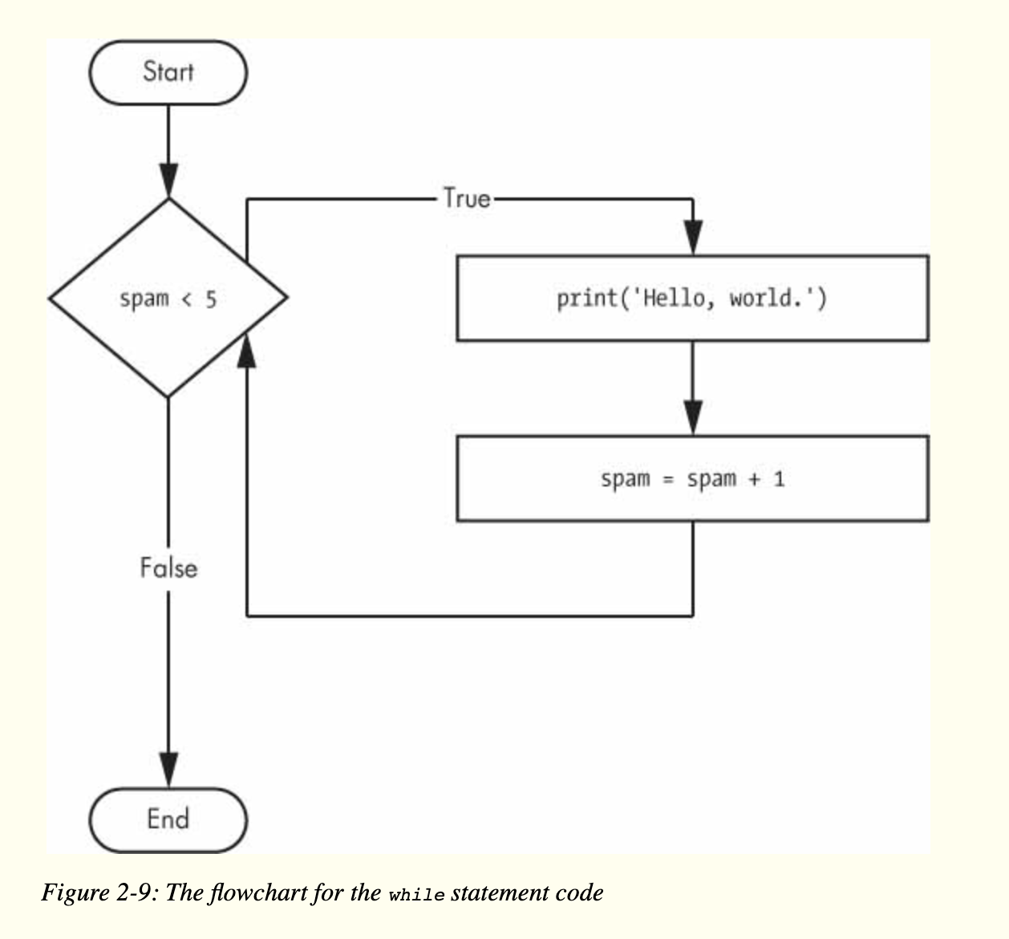
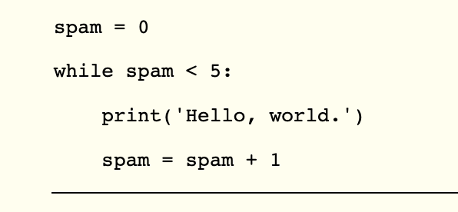
FOR Loops
WHILE Loops

Slide 12
What if you want to execute a block of code only a certain number of times?
print('My name is')
for i in range(5):
print('Jimmy Five Times (' + str(i) + ')')
The range() function can also be called with three arguments. The first two arguments will be the start and stop values, and the third will be the step argument. The step is the amount that the variable is increased by after each iteration.

Slide 13
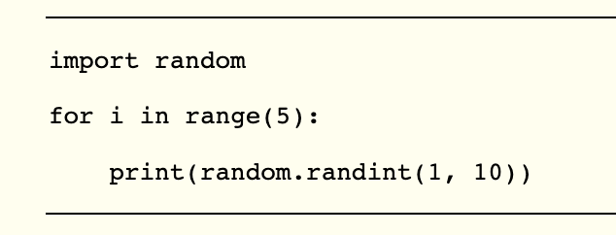
MODULES
Once you import a module, you can use all the cool functions of that module
Let’s give it a try with the random module, which will give us access to the random.randint() function

Slide 14
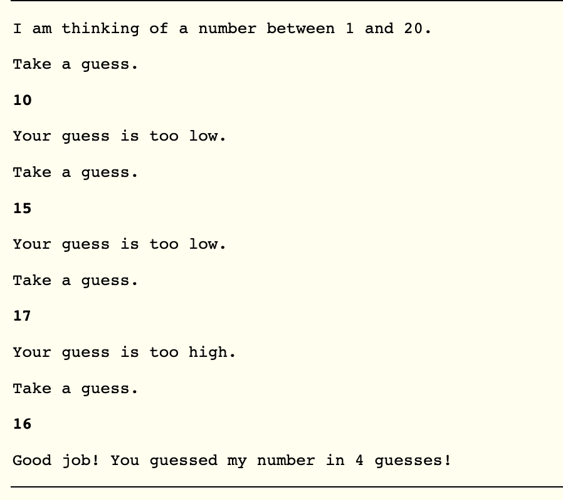
A Short Program: Guess The Number
# This is a guess the number game.
import random
secretNumber = random.randint(1, 20)
print('I am thinking of a number between 1 and 20.')
# Ask the player to guess 6 times.
for guessesTaken in range(1, 7):
print('Take a guess.')
guess = int(input())
if guess < secretNumber:
print('Your guess is too low.')
elif guess > secretNumber:
print('Your guess is too high.')
else:
break # This condition is the correct guess!
if guess == secretNumber:
print('Good job! You guessed my number in ' + str(guessesTaken) + '
guesses!')
else:
print('Nope. The number I was thinking of was ' + str(secretNumber))

Slide 15
Challenge Topic:
ELIF
The elif statement is an “else if” statement that always follows an if or another elif statement. It provides another condition that is checked only if all of the previous conditions were False

Slide 16
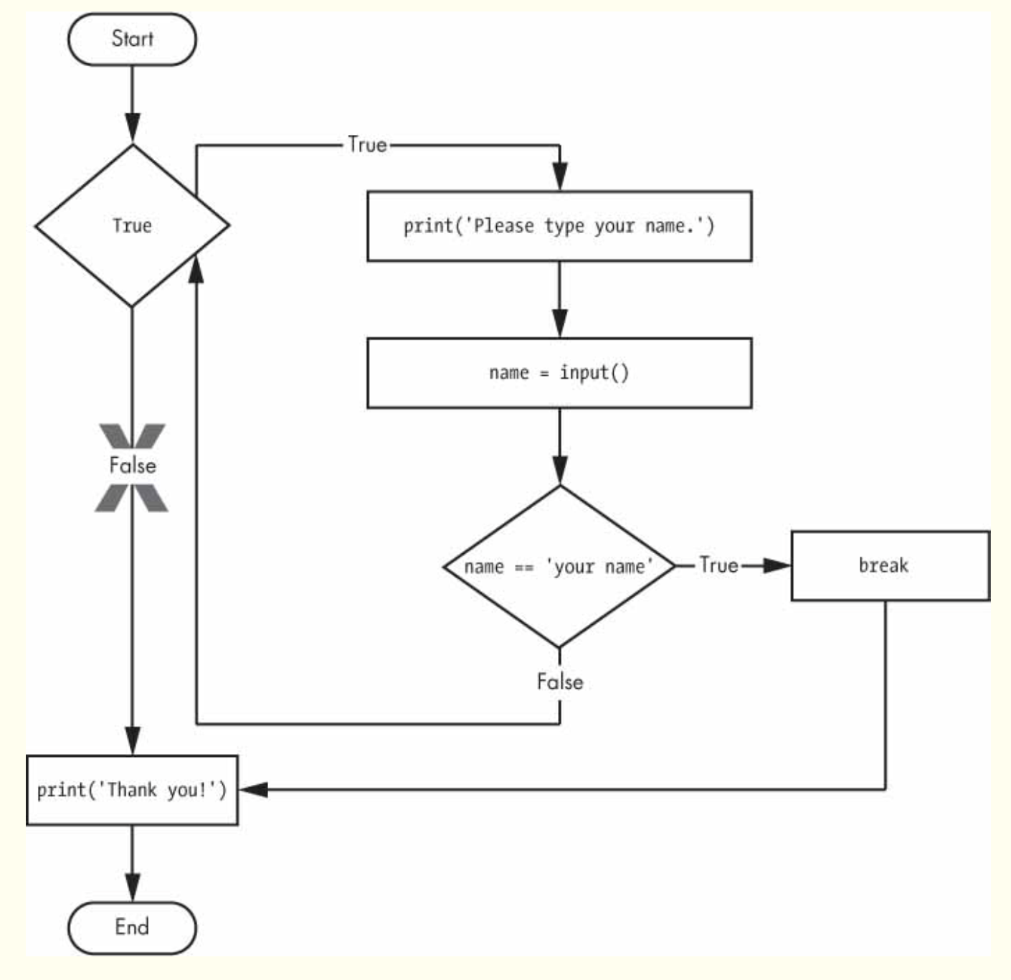
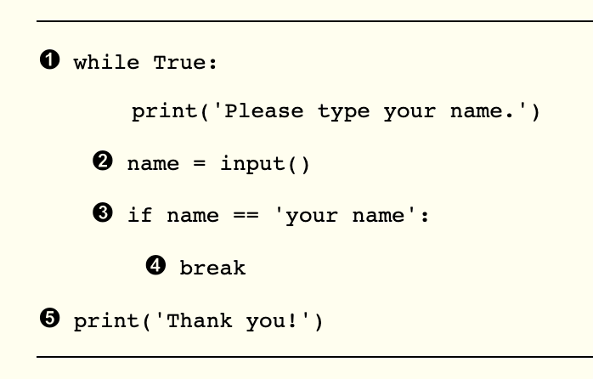
Challenge Topic:
BREAK
If the execution reaches a break statement, it immediately exits the while loop’s clause.

Slide 17
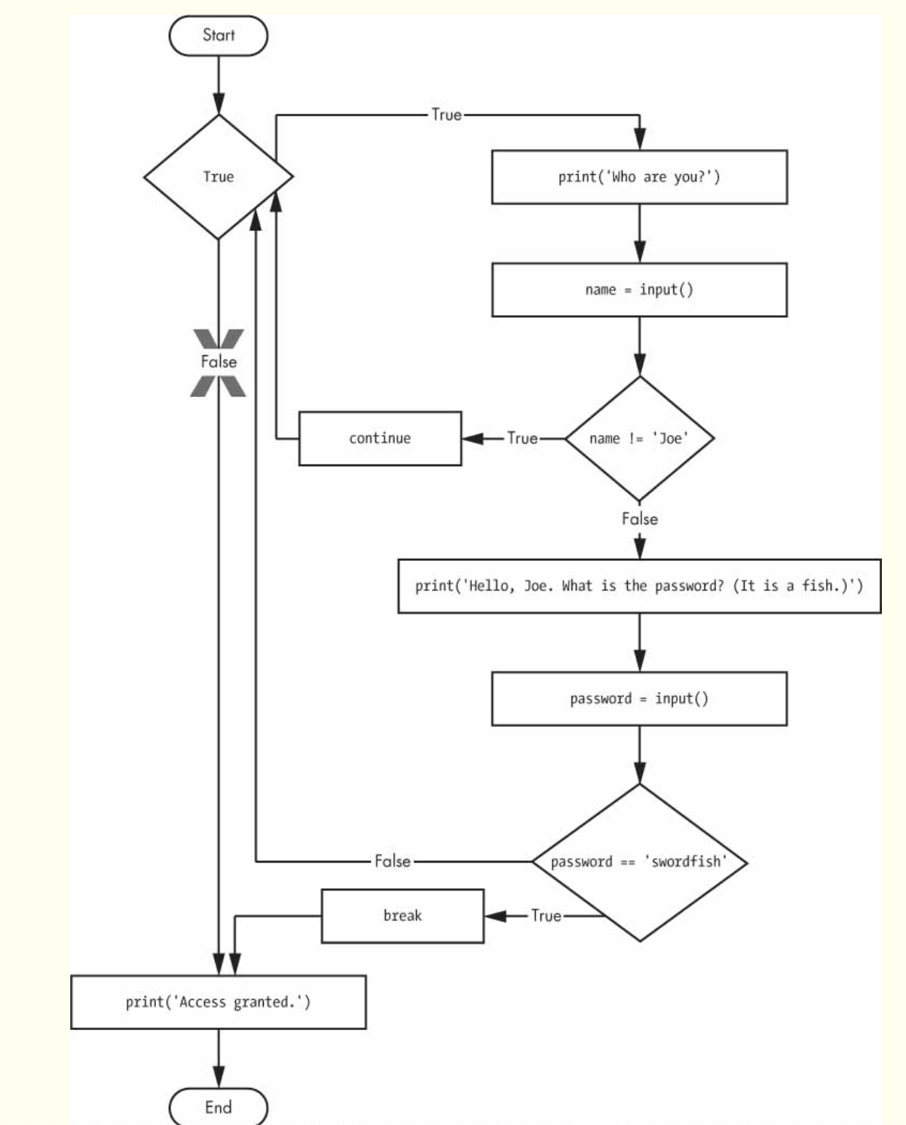
Challenge Topic:
CONTINUE
When the program execution reaches a continue statement, the program execution immediately jumps back to the start of the loop and reevaluates the loop’s condition. (This is also what happens when the execution reaches the end of the loop.)

Slide 18
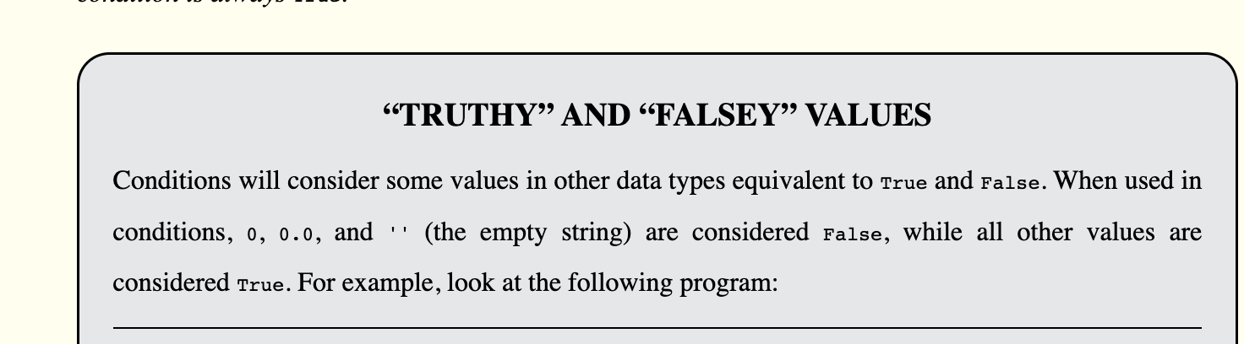
Challenge Topic:
TRUTHY and FALSEY

Slide 19
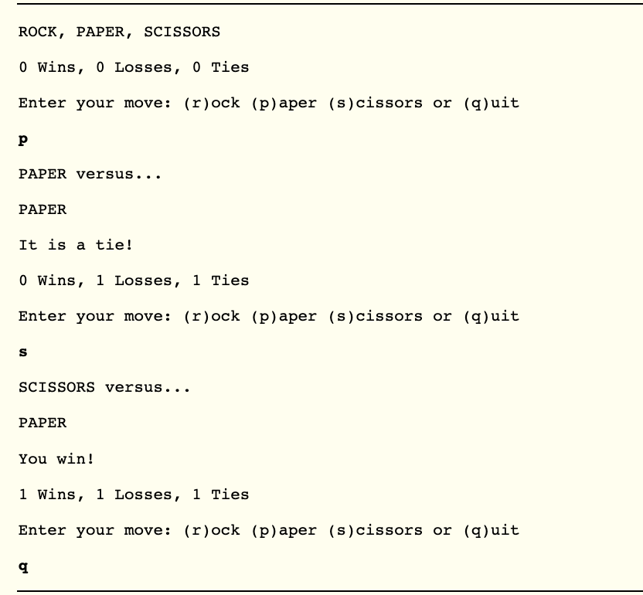
Challenge Program:
Rock, Paper, Scissors

Slide 20

Wrap Up and Next Steps
Homework: Read Chapter 3 of Automate the Boring Stuff
(It’s okay if you don’t understand it all – we’ll talk the concept next time, but it is a long chapter, and we will be moving fast, so it is helpful to familiarize yourself with the material)
How do you feel after this week?

